Slide 1



Slide 2
What is a String in C ?
Arrays : data structures that contain a collection of data objects of the same data type
Strings are really just arrays of characters
A string is an array of characters terminated by the NUL character
  Data type is array of characters
  The NUL character is a character with a numeric value of zero
    In C, it is represented by the escape sequence, \0 (NUL)
String constant (or string literal)
  Any series of characters enclosed in double quotes
    Ex. "Hello world"
String example program
  stores a string constant
  stores individual elements
    note: character constants
    note: terminate with '\0‘ to make the character array a string
Notes:
Run strings1.c in ChIDE. It prints out str1 ("Hello world") using the %s (string format specification). It also prints out str2 ("ME30") one element at time, including the NUL character (\0)
Characters are coded most often using the ASCII code. The decimal value of ASCII code for NUL is zero. The decimal value of the ASCII code for zero AS A CHARACTER is 48.

Slide 3
Strings as zero terminated array
In C a string is a zero-terminated array of characters
  char s[ ] = "asdf";
S :
'a'
's'
'd'
'f'
\0
  in C, the convention is to store a string as a char array, terminated with ’\0’
    char str[] = ”Dave”; str ’D’ ’a’ ’v’ ’e’ ’\0’

Slide 4
What is a String?
strings1.c
/* strings1.c */
#include <stdio.h>
int main()
{
int i;
char str1[] = "Hello world";
char str2[5];
str2[0]='M';
str2[1]='E';
str2[2]='3';
str2[3]='0';
str2[4]='\0';
printf("str1==%s\n",str1);
for(i=0; i<5; i++)
{
printf("str2[%d]==%c\n",i,str2[i]);
}
return 0;
}
Notes:
Run strings1.c in ChIDE. It prints out str1 ("Hello world") using the %s (string format specification). It also prints out str2 ("ME30") one element at time, including the NUL character (\0)
Characters are coded most often using the ASCII code. The decimal value of ASCII code for NUL is zero. The decimal value of the ASCII code for zero AS A CHARACTER is 48.

Slide 5
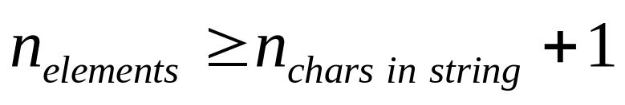
Initializing String Variables
Declare as an array of type char
  Can initialize implicitly
  or explicitly
  (using a string constant or using individual characters and a terminating NUL character)
    If explicit, make sure that:
/* strings1.c */
#include <stdio.h>
int main()
{
int i;
char str1[] = "Hello world";
char str3[12] = "Hello world";
char str2[5];
str2[0]='M';
str2[1]='E';
str2[2]='3';
str2[3]='0';
str2[4]='\0';
printf("str1==%s\n",str1);
for(i=0; i<5; i++)
{
printf("str2[%d]==%c\n",i,str2[i]);
}
return 0;
}
Notes:
Recall that characters are stored as one-byte integer values usually according to the American Standard Code for Information Interchange (ASCII). See the next slide for the ASCII code.
What is the difference between NULL and NUL? NULL is a macro defined in <stddef.h> for the null pointer. NUL is the name of the first character in the ASCII character set. It corresponds to a zero value. There’s no standard macro NUL in C, but some people like to define it. The digit 0 corresponds to a value of 48, decimal. Don’t confuse the digit 0 with the value of ‘\0’ (NUL)! NULL can be defined as ((void*)0), NUL as ‘\0’ (Source: http://www.geekinterview.com/question_details/3409) Visited: 19OCT2009.
NULL is a macro defined in several standard headers, 0 is an integer constant, '\0' is a character constant, and nul is the name of the character constant. All of these are *not* interchangeable:
NULL is to be used for pointers only since it may be defined as ((void *)0), this would cause problems with anything but pointers.
0 can be used anywhere, it is the generic symbol for each type's zero value and the compiler will sort things out.
'\0' should be used only in a character context.
nul is not defined in C or C++, it shouldn't be used unless you define it yourself in a suitable manner, like:
#define nul '\0' (Source: http://www.cprogramming.com/faq/cgi-bin/smartfaq.cgi?answer=1047589067&id=1043284376. Visited 19OCT09)
See also: http://www.lysator.liu.se/c/c-faq/c-1.html

Slide 6
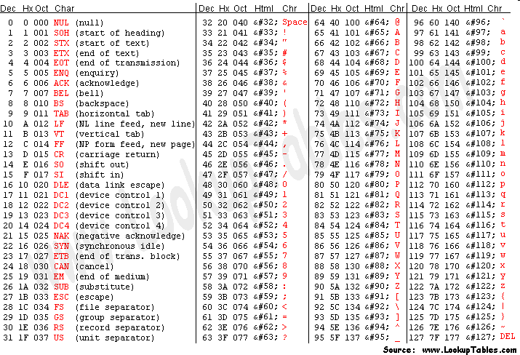
American Standard Code for Information Interchange (ASCII) Table

Slide 7
Printing Strings to stdout
/* strings1.c */
#include <stdio.h>
int main()
{
int i;
char str1[] = "Hello world";
char str3[12] = "Hello world";
char str2[5];
str2[0]='M';
str2[1]='E';
str2[2]='3';
str2[3]='0';
str2[4]='\0';
printf("str1==%s\n",str1);
for(i=0; i<5; i++)
{
printf("str2[%d]==%c\n",i,str2[i]);
}
return 0;
}
Can print an entire string using printf and %s format specification
Can print individual elements of a string by indexing and using %c format specification
Notes:
Stream == "a communications channel to a file, device, or process." http://www.cs.utah.edu/dept/old/texinfo/glibc-manual-0.02/library_11.html
The data type FILE is used to represent stream objects
printf prints to the stream standard output (stdout)

Slide 8
Manipulating Strings in C
No native support for strings in C
Use The Standard Function C Library for string
  #include <string.h>
Standard function libraries
<stdio.h> printf(), scanf(), etc.
<string.h> strcmp(), etc.
<ctype.c> isspace(), etc.
<stdlib.h> malloc(), etc.
<math.h> sqrt(), etc.
Notes:
Show http://www.cppreference.com/wiki/c/string/start and how to get to it from the ME 30 website

Slide 9
Copying and Concatenating Strings
to copy str2 to str1 (order resembles assignment):
  strcpy(str1, str2);
    str1 = str2; /* Will NOT work!! */
to add (concatenate) str2 to the end of str1:
  strcat(str1, str2);
    returns the value of str1 with str2 added to the end
      Note: it clobbers the /0 at the end of str1
      Make sure that str1 has room for str2
Notes:
str1 = str2; just makes str1 now contain the pointer to str2. Remember that the name of an array is essentially a constant pointer to the first element of the array.

Slide 10
Comparing strings
  if (strcmp(s1,s2) = = 0) { /* do s1 and s2 hold the same characters? */
  }

Slide 11
Finding the length of a string
Use strlen(string)
  returns length of the string
strlen() is a predefined function in C whose definition is contained in the header file “string.h”.
strlen() accepts a pointer to an array as argument and walks through memory at run time from the address we give it looking for a NULL character and counts up how many memory locations it passed before it finds one.
The main task of strlen() is to count the length of an array or string.

Slide 12
sizeof()
Sizeof operator is a compile time unary operator which can be used to compute the size of its operand.
The result of sizeof is of unsigned integral type which is usually denoted by size_t.
sizeof can be applied to any data-type, including primitive types such as integer and floating-point types, pointer types, or compound datatypes such as Structure, union etc.

Slide 13
Strings – Practice
Declare:
  A string variable named me30, and initialize it to hold the string, "ME 30 rocks!"
Determine
  The minimum number of character array elements needed to store the string
  length of the string
  What is stored in me30[2]?
  What is stored in me30[11]?
Notes:
char me30[]="ME 30 rocks"
The minimum number of elements
strlen("ME 30 rocks"); --> 11 the NUL character is NOT counted, so 12 elements are needed.
The third character (me30[2]) is a 'space'. The ASCII code is 32.
The thirteenth character (me30[12]) is ‘\0’, the NUL character.

Slide 14
#include <stdio.h>
#include <string.h>
int main ()
{
char me30[]="ME 30 rocks!";
int len1, len2, len3,len4 ;
len1 = strlen(me30);
printf("strlen(me30) : %d\n",len1);
len2 = sizeof(me30);
printf("size of (me30) : %d\n",len2);
len3 = strlen(me30)+1;
printf("strlen(me30)+1 : %d\n",len3);
len4 = sizeof(me30)/sizeof(char);
printf("sizeof(me30)/sizeof(char) : %d\n",len4);
printf("char in me30[2] : %c\n",me30[2]);
printf("char in me30[11] : %c\n",me30[11]);
printf("char in me30[10] : %c\n",me30[10]);
return 0;
}
Output
strlen(me30) : 12
size of (me30) : 13
strlen(me30)+1 : 13
sizeof(me30)/sizeof(char) : 13
char in me30[2] :
char in me30[11] : !
char in me30[10] : s

Slide 15
#include <stdio.h>
#include <string.h>
int main ()
{
char str1[10] = "Hello";
char str2[10] = "World";
char str3[10];
int len ;
// copy str1 into str3
strcpy( str3, str1);
printf("strcpy( str3, str1) : %s\n",str3);
// concatenates str1 and str2
strcat( str1, str2);
printf("strcat( str1, str2) : %s\n",str1);
// total lenghth of str1 after concatenation
len = strlen(str1);
printf("strlen(str1) : %d\n",len);
return 0;
}
Output
*** buffer overflow detected ***: ./prog terminated
char str1[11] = "Hello";
Output
strcpy( str3, str1) : Hello
strcat( str1, str2) : HelloWorld
strlen(str1) : 10

Slide 16
Strings
18
Creating String Objects
C-string
String in C : Array of chars that is null terminated (‘\0’).
C++ - string
Object whose string type is defined in the <string> file
has a large repertoire of functions (e.g. length, replace, etc.)
char cs[ ] = “Napoleon”; // C-string
string s = “Napoleon”; // C++ - string
cout << s << “ has “ << s.length() << “ characters.\n”;
s.replace(5, 2,”ia”); //changes s to “Napolian

Slide 17
Fundamentals of Characters and Strings
String
  Series of characters treated as one unit
  Can include letters, digits, special characters +, -, *
  String literal (string constants)
    Enclosed in double quotes, for example:
        "I like C++“
  Can also reference as an entire string
  Using functions found in the <cstring> library
if (strcmp (s, “hello”) == 0){...}
if (strlen (s) == 1){...}

Slide 18
Diganti
#include <string> apa yang akan terjadi ?
#include <iostream>
#include <cstring>
using namespace std;
int main ()
{
char str1[11] = "Hello";
char str2[10] = "World";
char str3[10];
int len ;
// copy str1 into str3
strcpy( str3, str1);
cout << "strcpy( str3, str1) : " << str3 << endl;
// concatenates str1 and str2
strcat( str1, str2);
cout << "strcat( str1, str2): " << str1 << endl;
// total lenghth of str1 after concatenation
len = strlen(str1);
cout << "strlen(str1) : " << len << endl;
return 0;
}
#include <iostream>
#include <string.h>
using namespace std;
int main ()
{
char str1[11] = "Hello";
char str2[10] = "World";
char str3[10];
int len ;
// copy str1 into str3
strcpy( str3, str1);
cout << "strcpy( str3, str1) : " << str3 << endl;
// concatenates str1 and str2
strcat( str1, str2);
cout << "strcat( str1, str2): " << str1 << endl;
// total lenghth of str1 after concatenation
len = strlen(str1);
cout << "strlen(str1) : " << len << endl;
return 0;
}

Slide 19
C ++ Strings
  Not necessarily null terminated
  string is not a pointer, but a class
  Many member functions take start position and length
    If length argument too large, max chosen

Slide 20
C ++ Strings
18
Creating String Objects
#include <string>
//string initialization
string s; //s contains 0 characters
string s1( "Hello" ); //s1 contains 5 characters
string s2 = “Hello”; //s2 contains 5 characters
//implicitly calls the constructor
string s3( 8, 'x' ); //s3 contains 8 'x' characters
string s4 = s3; //s4 contains 8 'x' characters
string s5(s2, 3, 2); //s5 copies a substring of s2; it contains ”lo”
string type in the <string> header file.
string_characteristics.cpp

Slide 21
C ++ Strings
18
String Objects
The C++ string class also defines a length() function for extracting
how many characters are stored in a string.
    cout << s.length() << endl;
Prints 4 for the string s == “Leon”
  You can also use the subscript operator [ ] to access individual characters:
  e.g. s[0] = ‘N’ ; //where index: 0 to length-1

Slide 22
#include <iostream>
#include <string>
using namespace std;
int main ()
{
string str1 = "Hello";
string str2 = "World";
string str3;
int len1, len2 ;
// copy str1 into str3
str3 = str1;
cout << "str3 : " << str3 << endl;
// concatenates str1 and str2
str3 = str1 + str2;
cout << "str1 + str2 : " << str3 << endl;
// total length of str3 after concatenation
len1 = str3.size();
cout << "str3.size() : " << len1 << endl;
len2 = str3.length();
cout << "str3.length() : " << len2 << endl;
return 0;
}
Output
str3 : Hello
str1 + str2 : HelloWorld
str3.size() : 10
str3.length() : 10

Slide 23
C ++ Strings
18
String Objects
You can also concatenate C++ strings using the + and += operators:
    string s = “ABCD*FG”;
    string s2 = “Robot”;
    string s5 = “Soccer”;
    string s6 = s + “HIJK”; //changes s6 to “ABCD*FGHIJK
s2 += s5; //changes s2 to “RobotSoccer”

Slide 24
Concatenation
Concatenation
  s3.append( "pet" );
  s3 += "pet";
    Both add "pet" to end of s3
  s3.append( s1, start, N );
    Appends N characters from s1, beginning at index start

Slide 25
Inserting Characters into a string
s1.insert( index, s2 )
  Inserts s2 before position index
s1.insert( index, s2, index2, N );
  Inserts substring of s2 before position index
  Substring is N characters, starting at index2

Slide 26
C ++ Strings
18
String Objects
C++ strings can be compared using relational operators just like
fundamental types:
    If(s2 < s5)
    cout << “s2 lexicographically precedes s5 \n”;
    while(s4==s3) //…

Slide 27
C ++ Strings
18
String Objects
Substring function: substr()
    s6 = “ABCD*FGHIJK”;
    s4 = s6.substr(5, 3); //changes s4 to “FGH”
s4 gets a substring of s6, starting at index 5 and taking 3 characters

Slide 28
C ++ Strings
18
String Objects
erase() and replace() functions:
    s6 = “ABCD*FGHIJK”;
    s6.erase(4, 2); //changes s6 to “ABCDGHIJK”;
    s6.replace(5, 2, “xyz”); //changes s6 to “ABCDGxyzJK”;
replace 2 characters from s6, starting at index 5, with “xyz”

Slide 29
C ++ Strings
18
String Objects
find() function
returns the index of the first occurrence of a given substring:
    string s7 = “Mississippi River basin”; //23 characters
    cout << s7.find(“si”) << endl; //prints 3
    cout << s7.find(“so”) << endl; //prints 23, the length of the string
If the find() function fails, it returns the length of the string it was searching.
i.e. find() returns 4,294,967,295

Slide 30
Assignment
Assignment
  s2 = s1;
    Makes a separate copy
  s2.assign(s1);
    Same as s2 = s1;
  myString.assign(s, start, N);
    Copies N characters from s, beginning at index start
  Individual character assignment
    s2[0] = s3[2];

Slide 31
Range-checking
Range-checking
  s3.at( index );
    Returns character at index
    Can throw an out_of_range exception
  [] has no range checking
#include <exception>
...
string s = "leon";
try{
char letter = s.at( 50 );
cout <<"letter is = " << letter << endl;
}
catch(exception& e){
cout << "out_of_range exception: " << e.what() << endl;
}

Slide 32
Comparing strings
Overloaded operators
  ==, !=, <, >, <= and >=
  returns bool
s1.compare(s2)
  returns positive if s1 is lexicographically greater
    compares letter by letter
    'B' lexicographically greater than 'A‘
    ‘a’ lexicographically greater than ‘A‘
    ‘a’ lexicographically greater than ‘Z‘
  returns negative if less; zero if equal
    Sample order: ‘A’,”Apple”, “Banana”, “Zest”, ‘a’, “apricot”, “leon”
  s1.compare(start, length, s2, start, length)
    Compare portions of s1 and s2
  s1.compare(start, length, s2)
    Compare portion of s1 with all of s2
Compare.cpp

Slide 33
Substrings
Function substr gets a substring
  s1.substr( start, N );
  gets N characters, beginning with index start
  returns substring

Slide 34
Finding Strings and Characters in a string
Find functions
  If found, index returned
  If not found, string::npos returned
    Public static constant in class string
  s1.find( s2 )
  s1.rfind( s2 )
    Searches right-to-left
  s1.find_first_of( s2 )
    Returns first occurrence of any character in s2
    Example: s1.find_first_of( "abcd" )
      Returns index of first 'a', 'b', 'c' or 'd'

Slide 35
Finding Strings and Characters in a string
Find functions
  s1.find_last_of( s2 )
    Finds last occurrence of any character in s2
  s1.find_first_not_of( s2 )
    Finds first character NOT in s2
  s1.find_last_not_of( s2 )
    Finds last character NOT in s2

Slide 36
Replacing Characters in a string
s1.erase( start )
  Erase from index start to end of string, including start
Replace
  s1.replace( begin, N, s2)
    begin: index in s1 to start replacing
    N: number of characters to replace
    s2: replacement string
  s1.replace( begin, N, s2, index, num )
    index: element in s2 where replacement comes from
    num: number of elements to use when replacing
  Replace can overwrite characters
others.cpp

Slide 37
Example
  s1.replace( begin, N, s2, index, num )
    begin: index in s1 to start replacing
    N: number of characters to replace
    s2: replacement string
    index: element in s2 where replacement comes from
    num: number of elements to use when replacing
string str = "this is an example string.";
string str3="sample phrase";
str.replace(19,6, str3, 7, 6); // "this is an example phrase."

Slide 38
C ++ Strings
18
String Objects
C++ strings can be converted to C-strings:
    string s = “ABCDEFG”;
const char* cs = s.c_str();
Converts s into the C-string cs.
The c_str() function has a return type const char*

Slide 39
Conversion to C-Style char*
Conversion functions
  Strings are not necessarily null-terminated
  s1.copy( ptr, N, index )
    Copies N characters into the array ptr
    Starts at location index
    Need to null terminate
char str[8];
string s2 = "cathode";
s2.copy(str, 5, 2); //copy 5 characters into str
//starting at index 2
//strcat(str,"\0"); //does not work
str[5] = '\0'; //this is required
cout << "str = " << str << endl;
cout << "s2 = " << s2 << endl;
Output:
str = thode
s2 = cathode

Slide 40
Conversion to C-Style char * Strings
Conversion functions
  s1.c_str()
    Returns const char *
    Null terminated
    e.g. Useful for filenames:
      ifstream in( s1.c_str() );
  s1.data()
    Returns const char *
    NOT null-terminated

Slide 41
Warning!
No conversion from int or char
  The following definitions could return errors, or
  warnings only, but then would cause the program to crash afterwards
    string error1 = 'c';
    string error2( 'u' );
    string error3 = 22;
    string error4( 8 );
  However, it can be assigned one char after its declaration:
    s = 'n';

Slide 42

cin and strings
The extraction operator can be used on cin to get strings of characters in the same way as with fundamental data types:
However, cin extraction always considers spaces (whitespaces, tabs, new-line...) as terminating the
value being extracted, and thus extracting a string means to always extract a single word, not a
phrase or an entire sentence.
To get an entire line from cin, there exists a function, called getline, that takes the stream (cin) as
first argument, and the string variable as second. For example:

Slide 43
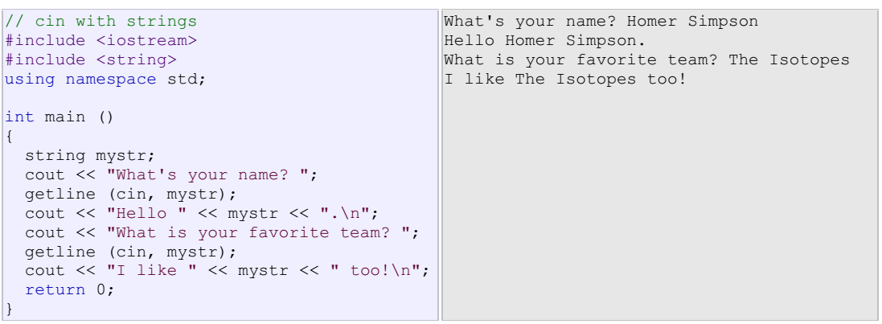
Notice how in both calls to getline, we used the same string identifier (mystr). What the program
does in the second call is simply replace the previous content with the new one that is introduced.

Slide 44
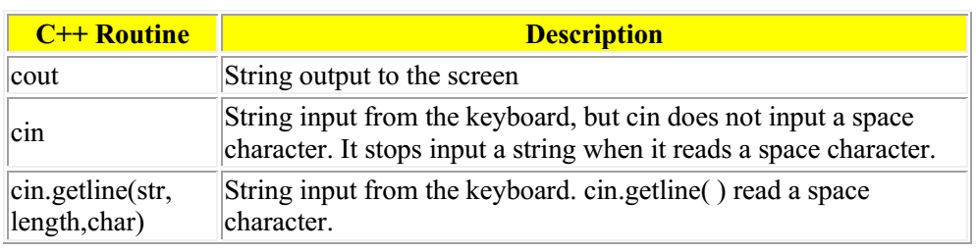
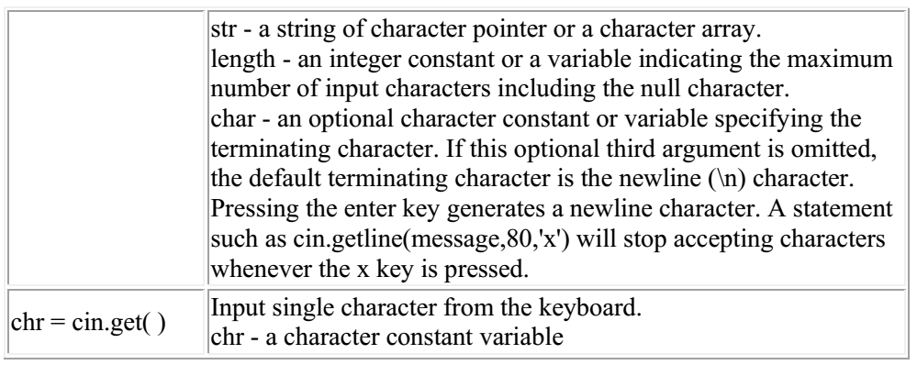
STRING INPUT AND OUTPUT

Slide 45
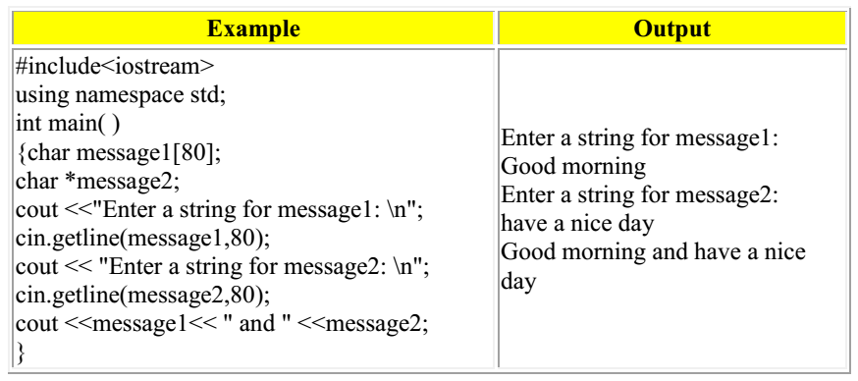

Slide 46
CHARACTER STRING FUNCTIONS
C++ provides several functions that allow you to test and manipulate character data.
The function prototypes are found in the header file name <ctype.h>. Remember to
add the line #include <ctype.h> in program that use these functions. The table below
lists and describes the character functions.
Each function expects one integer
argument - the ASCII value of the character to be tested. Each function returns a nonzero value (true) if the condition tested is true and 0 (false) if the condition tested is false.

Slide 47
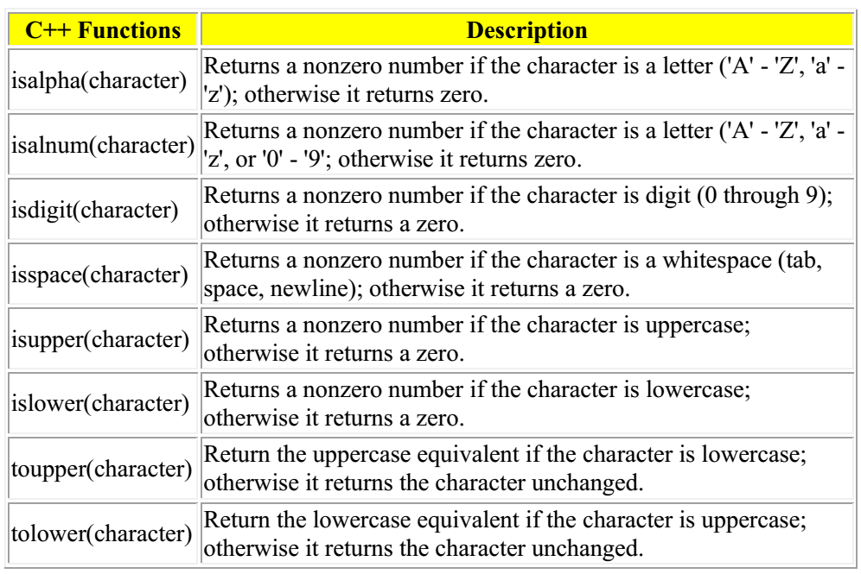

Slide 48
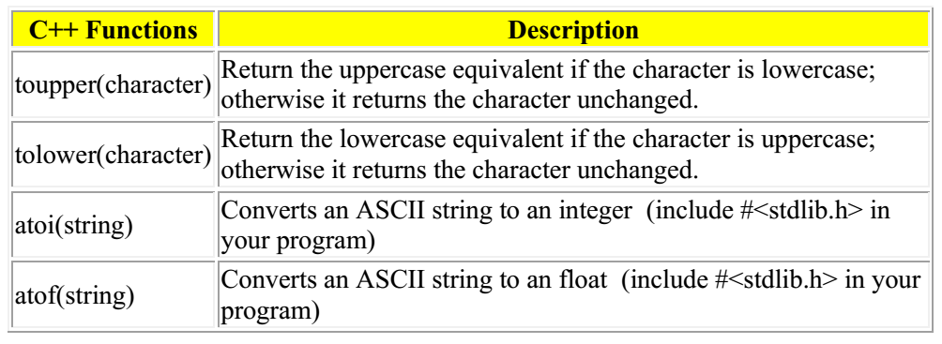

Slide 49
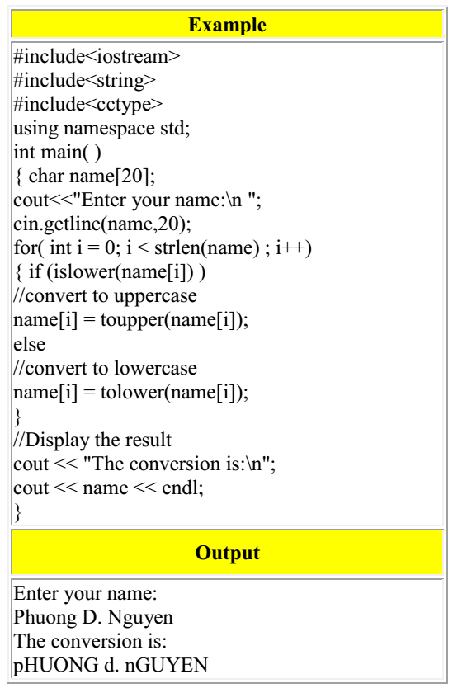


Slide 50
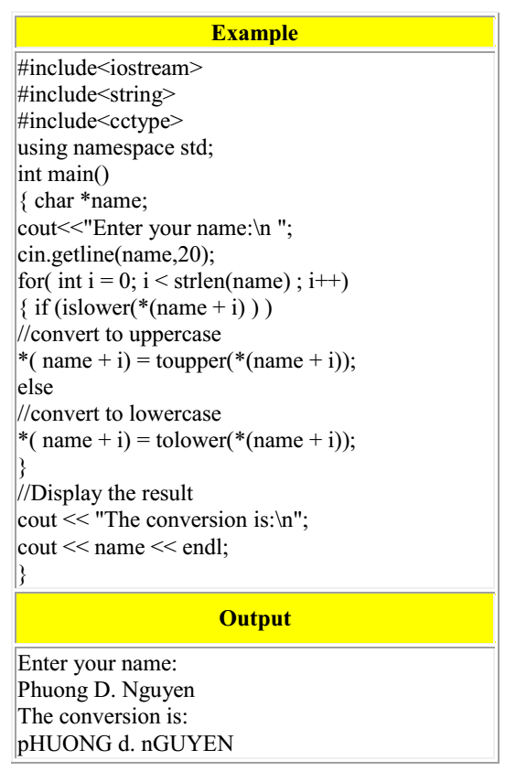

Slide 51
String Stream Processing
allows a string to be used as an internal file
useful for buffering input and output
I/O of strings to and from memory
  Called in-memory I/O or string stream processing
  Classes
    istringstream // input from string
    ostringstream // output to a string
    stringstream( string ) // most useful
    Requires <sstream> and <iostream> headers
  Use string formatting to save data to memory

Slide 52
Output String Stream
ostringstream oss;
int n = 44;
float x = 3.14;
oss << "Hello!\t" << n << '\t' << x;
string s = oss.str();
cout << endl << s << endl;
Serves as a conduit to an anonymous string which can be read
with the built-in oss.str() function that is bound to the oss object
Remember sprintf()?, how does it compare to this one?
output_string_stream.cpp

Slide 53
Input String Stream
const string buffer = oss.str();
istringstream iss(buffer);
string word;
int m;
float y;
iss >> word >> m >> y;
s = iss.str();
cout << endl << s << endl;
cout << "word = " << word << endl;
cout << "m = " << m << endl;
cout << "y = " << y << endl;
iss is defined and bound to buffer
Contents of buffer can be accessed
as elements of a string, or by
formatted input through the iss
object.
Remember sscanf()?, how does it compare to this one?
input_string_stream.cpp
All extractions from iss will come from the contents of buffer, as if
it were an external file.

Slide 54
#include <iostream>
#include <fstream>
#include <iomanip>
#include <string>
#include <sstream>
using namespace std;
int main(){
string s1("mydata.txt");
ifstream in( s1.c_str() );
char buffer[1024];
while( in.getline( buffer, 1024 ) ){
string stemp( buffer );
cout << "Line is:" << stemp << endl;
if( stemp[0] != '#' ){
stringstream stris( stemp );
double d1, d2;
stris >> d1 >> d2;
cout << d1 << "," << d2 << endl;
}
cout << endl;
}
in.close();
return 0;
}
Using string example
Input file:
1.0 2.0
1.1 2.4
1.8 2.8
#1.34 2.99
1.4 8.99
Example Output:
Line is:1.0 2.0
1,2
Line is:1.1 2.4
1.1,2.4
Line is:1.8 2.8
1.8,2.8
Line is:#1.34 2.99
Line is:1.4 8.99
1.4,8.99
(or could use strtok, C String tokenizers)

Slide 55
#include <iostream>
#include <fstream>
#include <iomanip>
#include <string>
#include <sstream>
using namespace std;
int main(){
string s1("mydata.txt");
ifstream in( s1.c_str() );
char buffer[1024];
while( in.getline( buffer, 1024 ) ){
string stemp( buffer );
cout << "Line is:" << stemp << endl;
if( stemp[0] != '#' ){
stringstream stris( stemp );
double d1, d2;
stris >> d1 >> d2;
cout << d1 << "," << d2 << endl;
}
cout << endl;
}
in.close();
return 0;
}
int main(){
string s1("mydata.txt");
ifstream in( s1.c_str() );
string buffer;
while(getline( in, buffer ) ){
cout << "Line is:" << buffer << endl;
if( buffer[0] != '#' ){
istringstream stris( buffer );
double d1, d2;
stris >> d1 >> d2;
cout << "data: " << d1 << "," << d2 << endl;
}
cout << endl;
}
in.close();
return 0;
}
Alternatively: (no C-style char*)
File_stringstream2.cpp

Slide 56
Summary
C++ strings are safer and easier to use than C string.
Next Templates

Slide 57







Method | Use
append(char *pt); append(char *pt, size_t count); append(string &str, size_t offset,size_t count); append(string &str); append(size_t count, char ch); append(InputIterator Start, InputIterator End); | Appends characters to a string from C-style strings, char's or other string objects.
at(size_t offset); | Returns a reference to the character at the specified position. Differs from the subscript operator, [], in that bounds are checked.
begin(); | Returns an iterator to the start of the string.
*c_str(); | Returns a pointer to C-style string version of the contents of the string.
clear(); | Erases the entire string.
copy(char *cstring, size_t count, size_t offset); | Copies "count" characters into a C-style string starting at offset.
empty(); | Test whether a string is empty.
end(); | Returns an iterator to one past the end of the string.
erase(iterator first, iterator last); erase(iterator it); erase(size_t pos, size_t count); | Erases characters from the specified positions.
• C-Style Character Arrays
• String Class
• String Operations
• String Class Methods
• Using String Methods
More of this Feature

Slide 58
Method | Use
find(char ch,size_t offset = 0); find(char *pt,size_t offset = 0); find(string &str,size_t offset = 0); | Returns the index of the first character of the substring when found. Otherwise, the special value "npos" is returned.
find_first_not_of(); | Same sets of arguments as find. Finds the index of the first character that is not in the search string.
find_first_of(); | Same sets of arguments as find. Finds the index of the first character that is in the search string.
find_last_not_of(); | Same sets of arguments as find. Finds the index of the last character that is not in the search string.
find_last_of(); | Same sets of arguments as find. Finds the index of the last character that is in the search string.
insert(size_t pos, char *ptr); insert(size_t pos, string &str); insert(size_t pos, size_t count, char ch); insert(iterator it, InputIterator start, InputIterator end); | Inserts characters at the specified position.
push_back(char ch); | Inserts a character at the end of the string.
replace(size_t pos, size_t count, char *pt); replace(size_t pos, size_t count, string &str); replace(iterator first, iterator last, char *pt); replace(iterator first, iterator last, string &str); | Replaces elements in a string with the specified characters. The range can be specified by a start position and a number of elements to replace, or by using iterators.
size(); | Returns the number of elements in a string.
swap(string &str); | Swaps two strings.

Slide 59


Questions?

